Slide 1




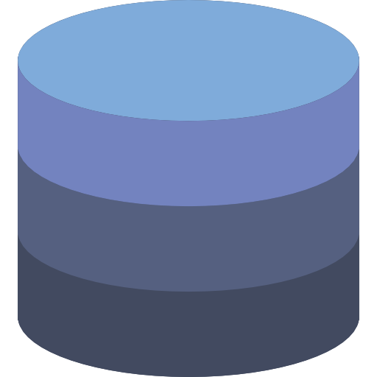



SQL Tutorial
SQL
YouTube: @theplacementschool1

Slide 2
















Agenda
1
What Is a Database?
2
Types of Database Architecture
3
Introduction to SQL
4
Tables in SQL

Slide 3







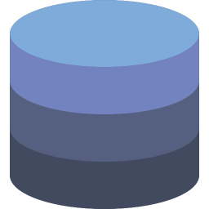







What Is a Database?
An organized collection of data stored in an electronic format
Access Data
Manipulate Data
Data
Database
Update Data

Slide 4



Database Management System
DBMS is a system software for creating and managing databases.
Database
DBMS

Slide 5

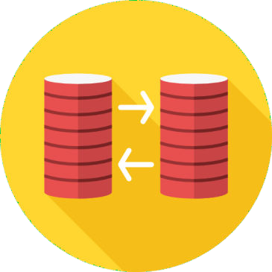
Types of Database Architecture
File Server
Client Server

Slide 6








File Server Architecture
Files
Local System

Slide 7




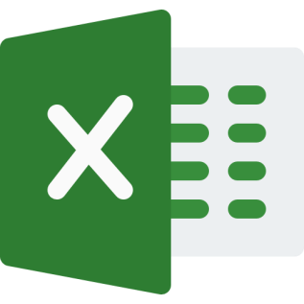


File Server Architecture
Changes in the Original File
Do Not Reflect in the Copy
Original File
Copy

Slide 8








File Server Architecture
Server/Local File System

Slide 9
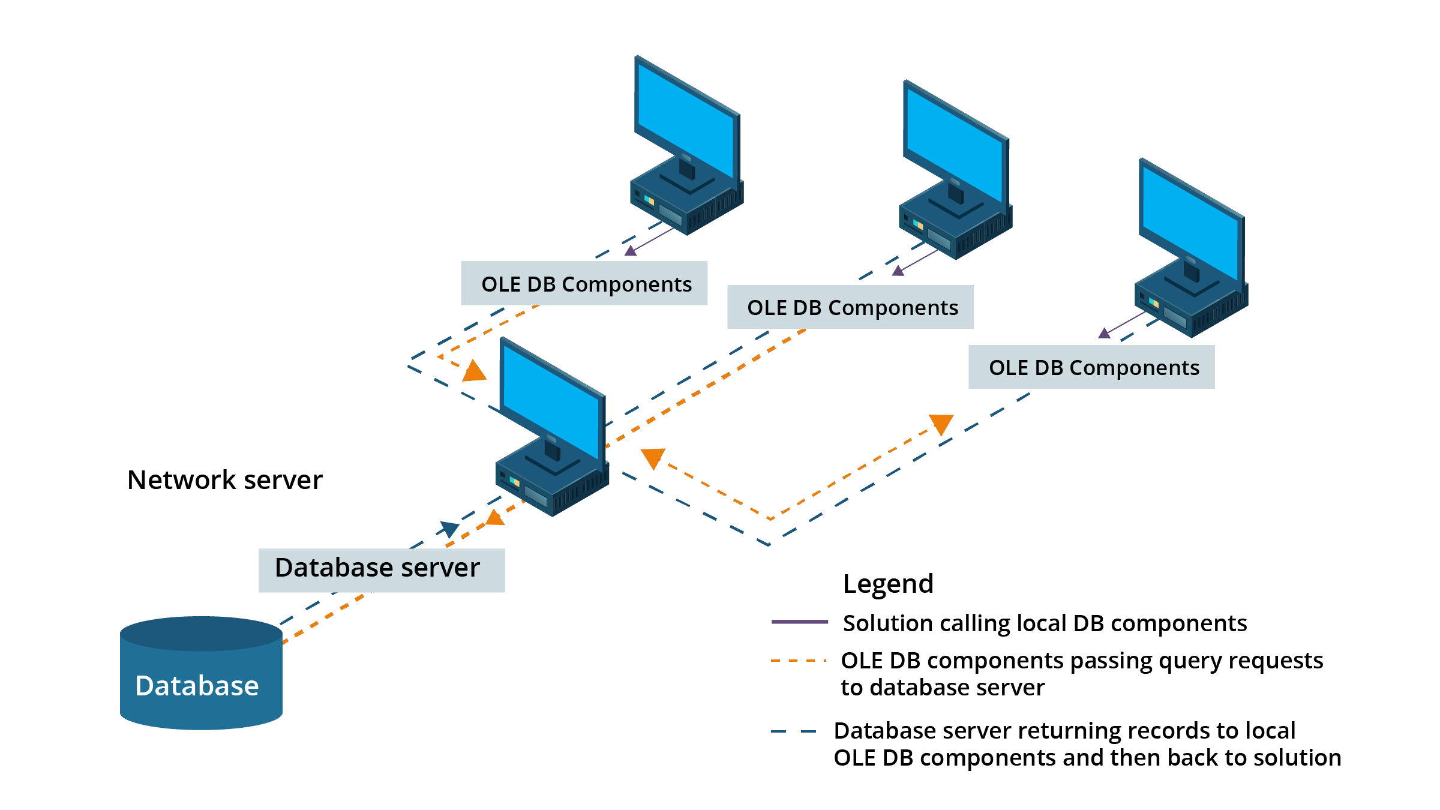
Client Server Architecture

Slide 10


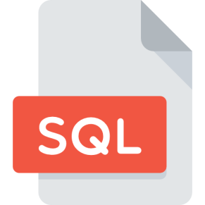

Introduction to SQL
SQL stands for Structured Query Language which is a standard language for accessing and manipulating databases.

Slide 11










Categories of SQL Commands
Data Query Language
Data Definition Language
Data Manipulation Language
Data Control Language
Create Table
Insert
Grant
Select
Alter Table
Update
Revoke
Drop Table
Delete

Slide 15

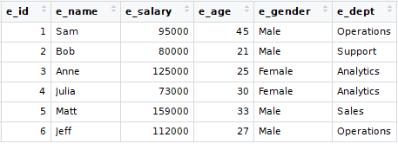
Tables in SQL
A table is a database object which comprises rows and columns.

Slide 16







Fields and Records
Record
Field

Slide 17

Fields
A field provides specific information about the data in a table.

Slide 18
Records
Each individual entry in a table is called a record.

Slide 19
Quiz

Slide 20








Quiz
What does SQL stand for?
A
Strong Question Language
B
Structured Question Language
C
Structured Query Language
D
None of these

Slide 21
Solution
What does SQL stand for?
A
Strong Question Language
B
Structured Question Language
C
Structured Query Language
D
None of these

Slide 22
Quiz
Which of these are different categories of SQL commands?
A
Data Query Language
B
Data Definition Language
C
Data Manipulation Language
D
All of these

Slide 23
Solution
Which of these are different categories of SQL commands?
A
Data Query Language
B
Data Definition Language
C
Data Manipulation Language
D
All of these

Slide 24
Quiz
Grant & Revoke come under which category of SQL commands?
A
Data Query Language
B
Data Definition Language
C
Data Manipulation Language
D
Data Control Language

Slide 25
Solution
Grant & Revoke come under which category of SQL commands?
A
Data Query Language
B
Data Definition Language
C
Data Manipulation Language
D
Data Control Language

Slide 26
Quiz
Which of these is true about Records?
A
One individual column in a table is known as a record
B
One individual row in a table is known as a record
C
A record should have data of only one type
D
Each cell in a record can be of different data type

Slide 27
Solution
Which of these is true about Records?
A
One individual column in a table is known as a record
B
One individual row in a table is known as a record
C
A record should have data of only one type
D
Each cell in a record can be of different data type

Slide 28

Thank You

